Slide 1


Pixelwise Instance Segmentation with a Dynamically Instantiated Network
Anurag Arnab, Philip H.S. Torr
Notes:
Good afternoon
I am going to be talking about my recent CVPR paper about Instance Segmentation

Slide 2
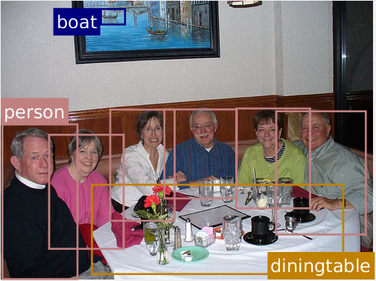
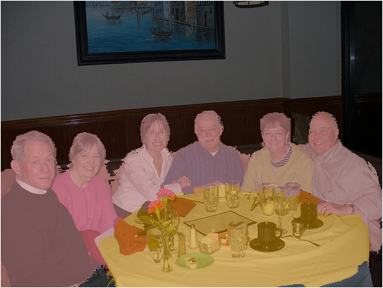
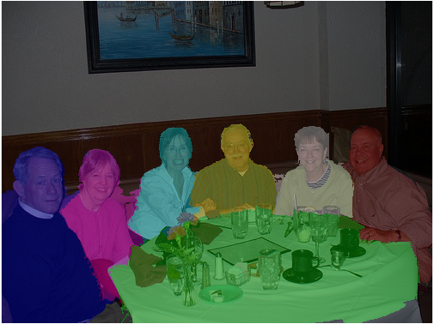
Instance Segmentation
Object Detection [1]
Semantic Segmentation
Instance Segmentation
[1] Faster-RCNN. Ren et al. NIPS 2015.
Notes:
Object Detection and Semantic Segmentation are two commonly studied Scene Understanding problems.
Semantic Segmentation labels every pixel in an image with its object class. However, it has no notion of different instances of the same class. So it labels every person as the same.
Object Detection, on the other hand, does have a notion of different instances.
However, it does so at a coarse, bounding-box level.
Instaance segmentation is at the intersection of these two tasks, and is becoming an increasingly popular problem.

Slide 3
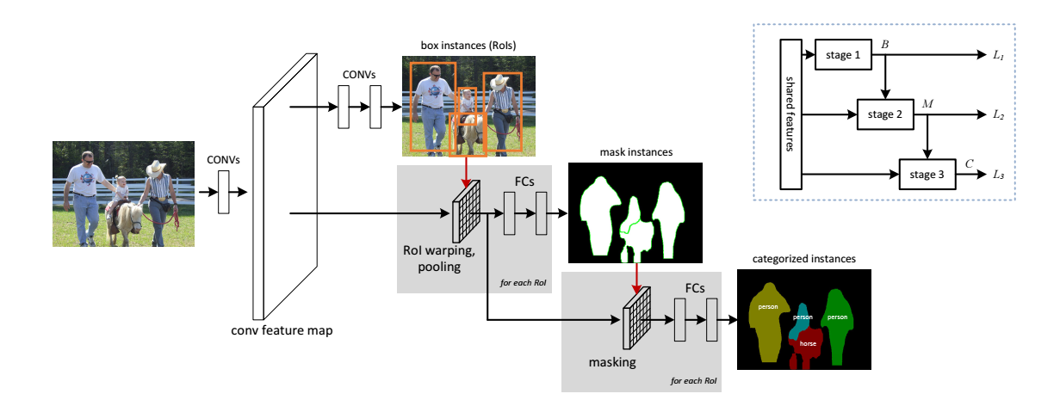
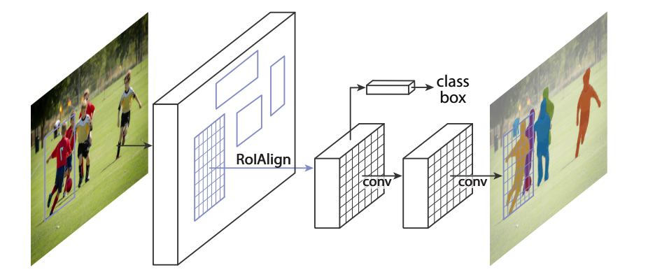
Detection based approaches
Most Instance Segmentation methods are based on Object Detection networks which are refined to produce segments instead of bounding boxes.
Multi-task Network Cascades (MNC). Dai et al. 2016
Mask R-CNN. He et al. 2017
Hariharan et al. 2014, 2015. Chen et al 2015. Dai et al. 2015. Liu et al. 2016. Li et al. 2016. Qi et al. 2017
Notes:
Many of the proposed instance segmentation methods are based on object detectors which have been modified to output masks instead of boxes.
Common examples being MNC, and its successor, Mask-RCNN.

Slide 4
Detection based approaches
Process independent object proposals
More proposals than actual objects in the image
Pixels can be ambiguous – can be assigned to multiple proposals
Limited by quality of initial proposals
Cannot segment instances outside the detected box
Detectors produce a ranked list of proposed instances and scores
Some methods cannot produce actual segmentation maps
Others require post-processing
Notes:
However, all of these detection-based approaches have a common set of limitations.
They produce a ranked list of proposed instances and scores, instead of actual segmentation maps of the image like I showed in the first slide.
And quite significantly, they process all these different object proposals independently of one another.
So this means that one pixel can end up being assigned to multiple objects.
And occlusions are not really handled at all.
There are also more object proposals than actual instances in the image, but maybe counterintuitively, the AP metric which is used in benchmarks actually favours this.
Moreover, since these systems are based on initial box-based proposals, they are limited by the initial quality of these boxes, and cannot actually go “outside of them”.

Slide 5
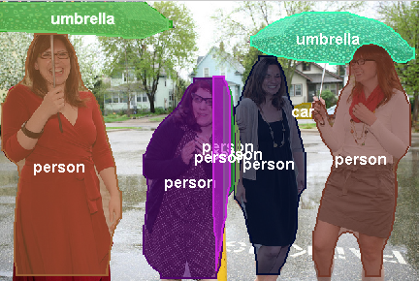
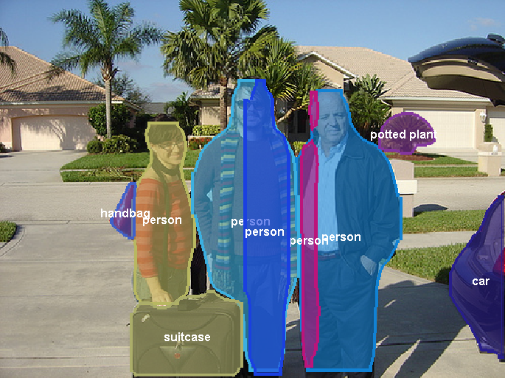
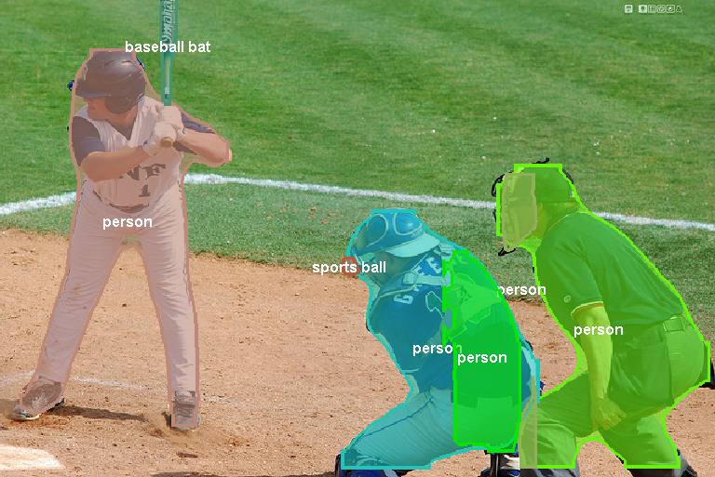
Detection based approaches
Results of FCIS [1]. Winner of last COCO challenge
[1] Qi et al. CVPR 2017.
Notes:
So here you can see some examples of how these limitations show up in images. These failure modes are actually quite systematic if you look through all the images.
These results are from the Microsoft Asia team which won the most recent COCO challenge, and put all their results online. https://onedrive.live.com/?authkey=%21ABB_CV2zvCEoNK0&id=F371D9563727B96F%2192190&cid=F371D9563727B96F
You can see that far many more people than actually present are being predicted in the image.
Moreover, in many of the overlapping parts, the pixel actually belongs to multiple different person instances.
Occlusions between different instances are not really being handled at all.
And the segmentation quality is relatively poor compared to semantic segmentation papers.
And as you can see, just by thresholding the scores of different masks, they cannot even count the number of instances in the image.
And its worth noting that you need to do post-processing to produce these results. The algorithm itself outputs a list of segmented masks and their scores. The final visualisation is produced by taking the maximum scoring instance at each pixel, and heuristically merging some proposals together as well.

Slide 6
Approach
Based on a Semantic Segmentation network
Outputs a variable number of instances depending on the image
Reasons about the entire image holistically
Pixel can only belong to a single instance
Therefore has to reason about occlusions
Produces segmentation maps directly
Requires no post-processing
Segmentations are more precise
Notes:
So our proposed approach attempts to address the problems that I mentioned.
In contrast to most other methods which modify object detectors to output instances, we augments an instance-agnostic semantic segmentation network to output instances.
As we do not process independent proposals, we have to deal with a variable number of instances per image. Which is effectively a dynamic label space.
And since we our network outputs a segmentation map where each pixel is only assigned one label, it means that it has to learn to reason about occlusions.
Moreover, it also means that we do not require any post-processing unlike all the other methods.

Slide 7
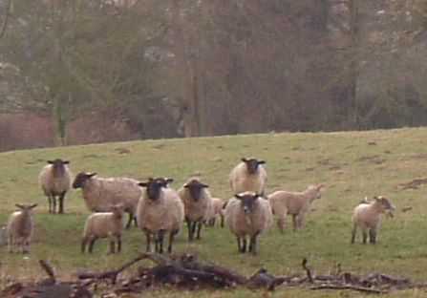
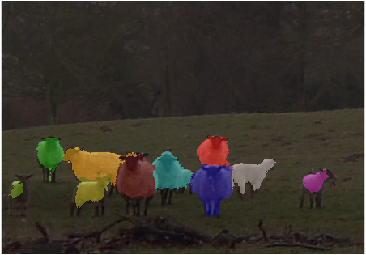
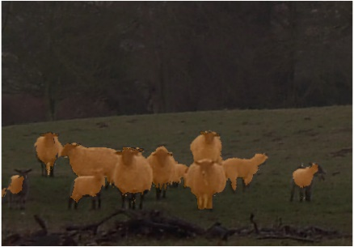
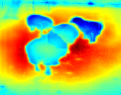
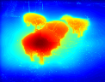
Overview
End-to-end Network
Detector
Instance Unary Potentials
Box
Pixelwise CNN
Semantic CRF
Global
Instance CRF
Shape
D+1
Input Image
Instance Segmentation
K+1
Semantic Segmentation
Semantic Segmentation subnetwork Instance Segmentation subnetwork
[1] Arnab et al. ECCV 2016.
Notes:
So our proposed approach is based on an initial semantic segmentation.
We use this initial category-level segmentation, along with the cues of an object detector to reason about instances.
Basically, we associate each pixel in the semantic segmentation with a detection. The result is an instance segmentation.
This makes the assumption that the number of object detections is the number of possible instances.
However, since we can handle false positive detections, this is not much of an issue as we can use a small threshold on the detections.
So although are network has two parts – a semantic segmentation part and an instance part – all of these modules are differentiable and so we can backpropogate through it.
Additionally, since we are using detections in our instance part of the network, we also use them in the semantic segmentation part with a Higher Order potential. I can describe this later if there is time.

Slide 8
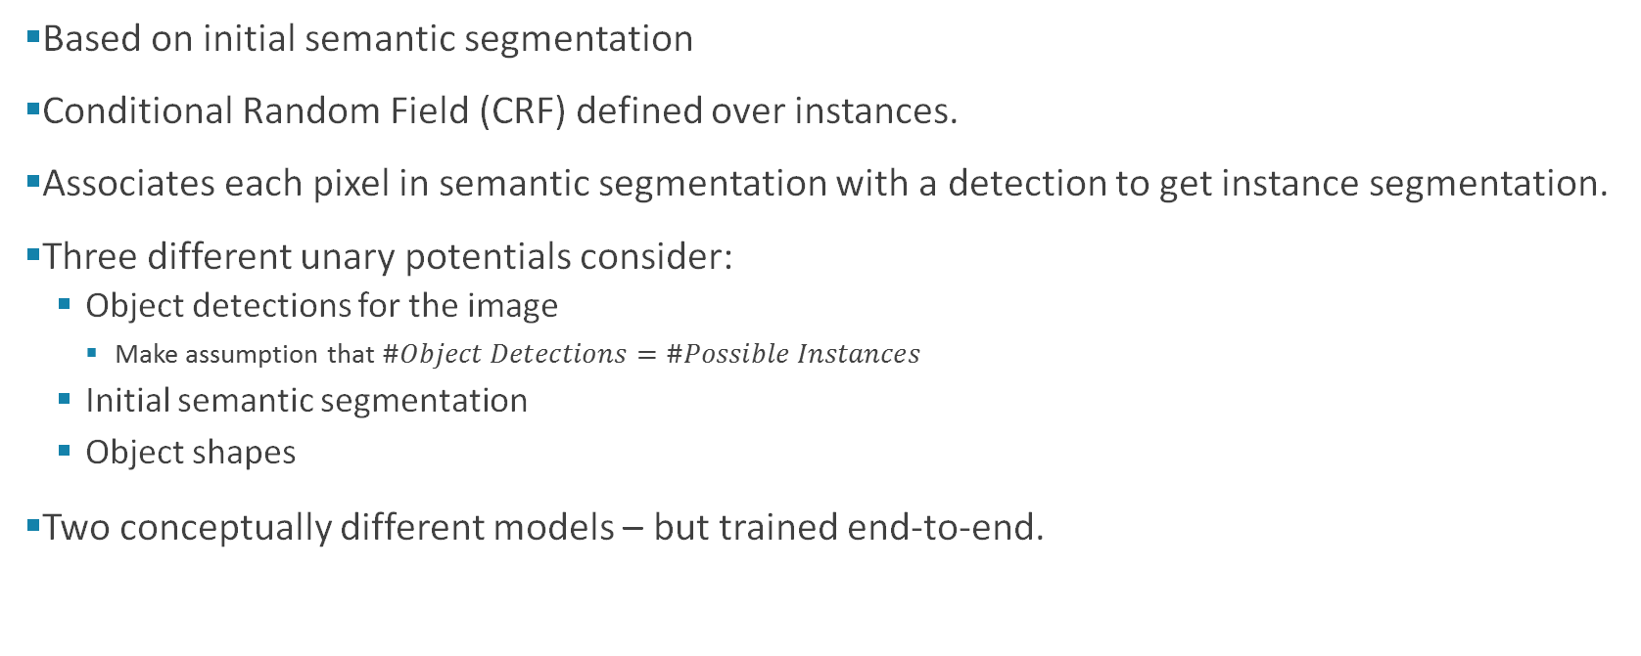
Approach
Based on initial semantic segmentation
Conditional Random Field (CRF) defined over instances.
Associates each pixel in semantic segmentation with a detection to get instance segmentation.
Three different unary potentials consider:
Object detections for the image
Make assumption that $\#Object Detections=\#Possible Instances$
Initial semantic segmentation
Object shapes
Two conceptually different models – but trained end-to-end.
Notes:
So our proposed approach is based on an initial semantic segmentation.
We use this initial category-level segmentation, along with the cues of an object detector to reason about instances.
Basically, we associate each pixel in the semantic segmentation with a detection. The result is an instance segmentation.
This makes the assumption that the number of object detections is the number of possible instances.
However, since we can handle false positive detections, this is not much of an issue as we can use a small threshold on the detections.
So although are network has two parts – a semantic segmentation part and an instance part – all of these modules are differentiable and so we can backpropogate through it.
Additionally, since we are using detections in our instance part of the network, we also use them in the semantic segmentation part with a Higher Order potential. I can describe this later if there is time.

Slide 9
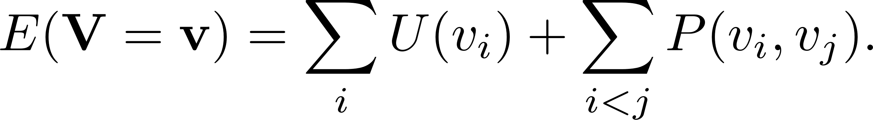
Approach
Pairwise terms are the same Gaussian kernels as DenseCRF [1]
where D is the number of detections and changes for every image.
[1] Krahenbuhl and Koltun. NIPS 2011.
Notes:
So we define a conditional random field over our instances.
We assume there are D detections for the image, where D varies for each image, meaning that each pixel can take on 1 of (D+1) labels.
We have three separate unary potentials which take the initial semantic segmentations and object detections into account.
There is also the densely connected pairwise term that is quite common in segmentation. It basically takes on the form of a bilateral filter which encourages nearby pixels that are close to each other in space and appearance to take on the same label.
Our potential function share the same parameters for each label, allowing it to deal with an arbitrary number of instances.

Slide 10
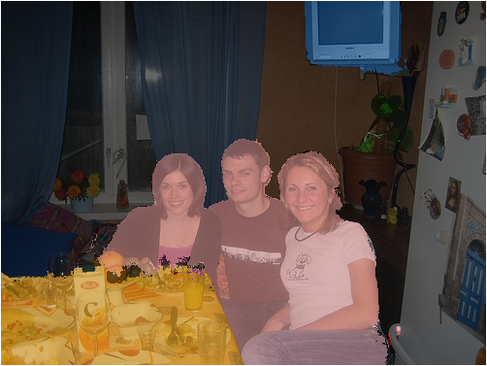
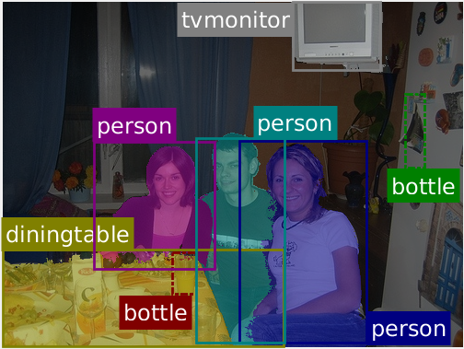
Box Term
Based on intuition that if segmented pixel lies within bounding box and has the same class, then it belongs to the instance represented by that class
Works well when we have good initial semantic segmentation
Notes:
The first unary term is the box term.
It is quite intuitive – if a segmented pixel lies within a bounding box and has the same class, then it belongs to the instance represented by that detection.

Slide 11
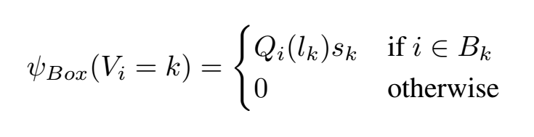
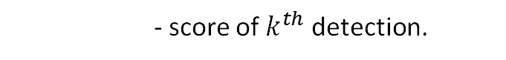
Box Term
- probability of $i^{th}$ pixel taking on label of $k^{th}$ detection.
- score of $k^{th}$ detection.
Notes:
This is proportional to our segmentation confidence of the detected class, and the detection score.
Note that we can deal with false positive detections here, if the object detection and semantic segmentation do not agree with each other.
In conjunction with the pairwise term, we can get accurate results as shown in the figure here.

Slide 12
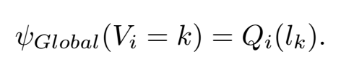
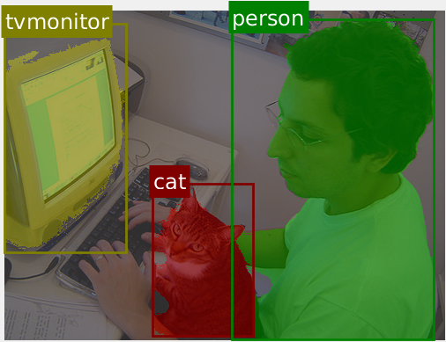
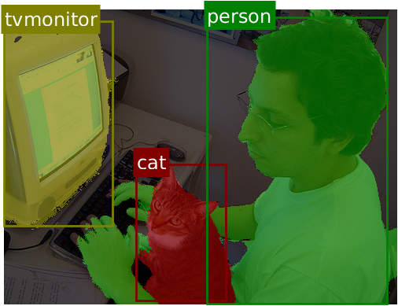
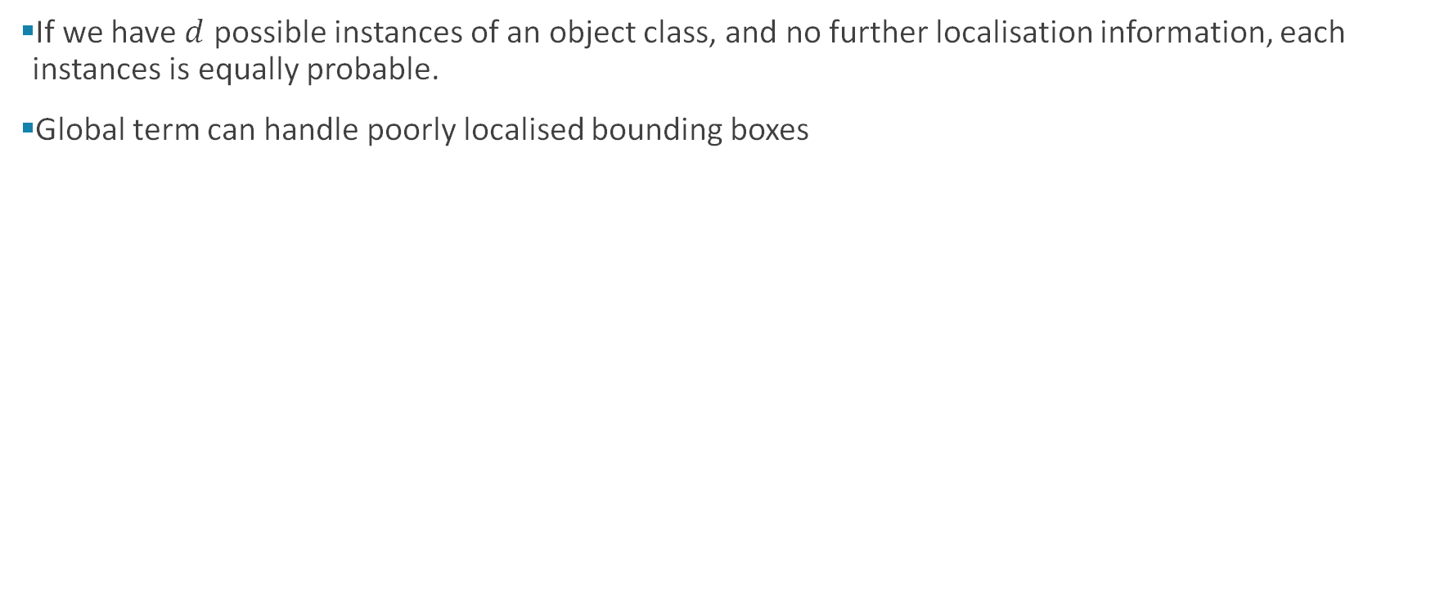
Global Term
If we have $d$ possible instances of an object class, and no further localisation information, each instances is equally probable.
Global term can handle poorly localised bounding boxes
Notes:
The global term, on the other hand, is not based on bounding boxes.
It is actually there to help deal with poorly localised bounding boxes which do not cover the whole object. Intuitively, we need a term independent of bounding boxes to be able to segment outside the box.
It basically says that if we have d possible instances of an object class, in the absence of any further information, each instance is equally as likely as the other.

Slide 13
Global Term
Gradients depend on entire semantic segmentation map, and are hence more stable
Semantic Segmentation performance also improves with end-to-end training
Notes:
You can see that this term allows the hands of the person, which are outside the bounding box, to be segmented. This is because the initial semantic segmentation had segmented the person properly.
An added benefit of this is that the final instance segmentation now depends on every single pixel in the initial semantic segmentation input. This makes gradients more stable during training.

Slide 14
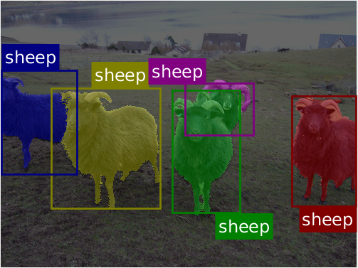
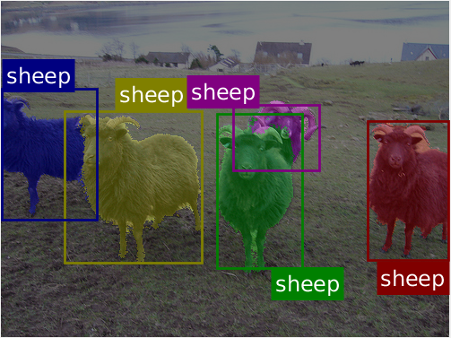
Shape Term
Intuitively, shape priors help us reason about occluded objects which look the same
Without shape priors
With shape priors
Notes:
The shape term is formulated to help with occlusions.
As you can see in this example, it is very difficult to distinguish objects that look the same and occlude each other. Such as sheep
However, if you had a prior of what different objects look like, you can reason about the foreground and background objects within a bounding box.

Slide 15
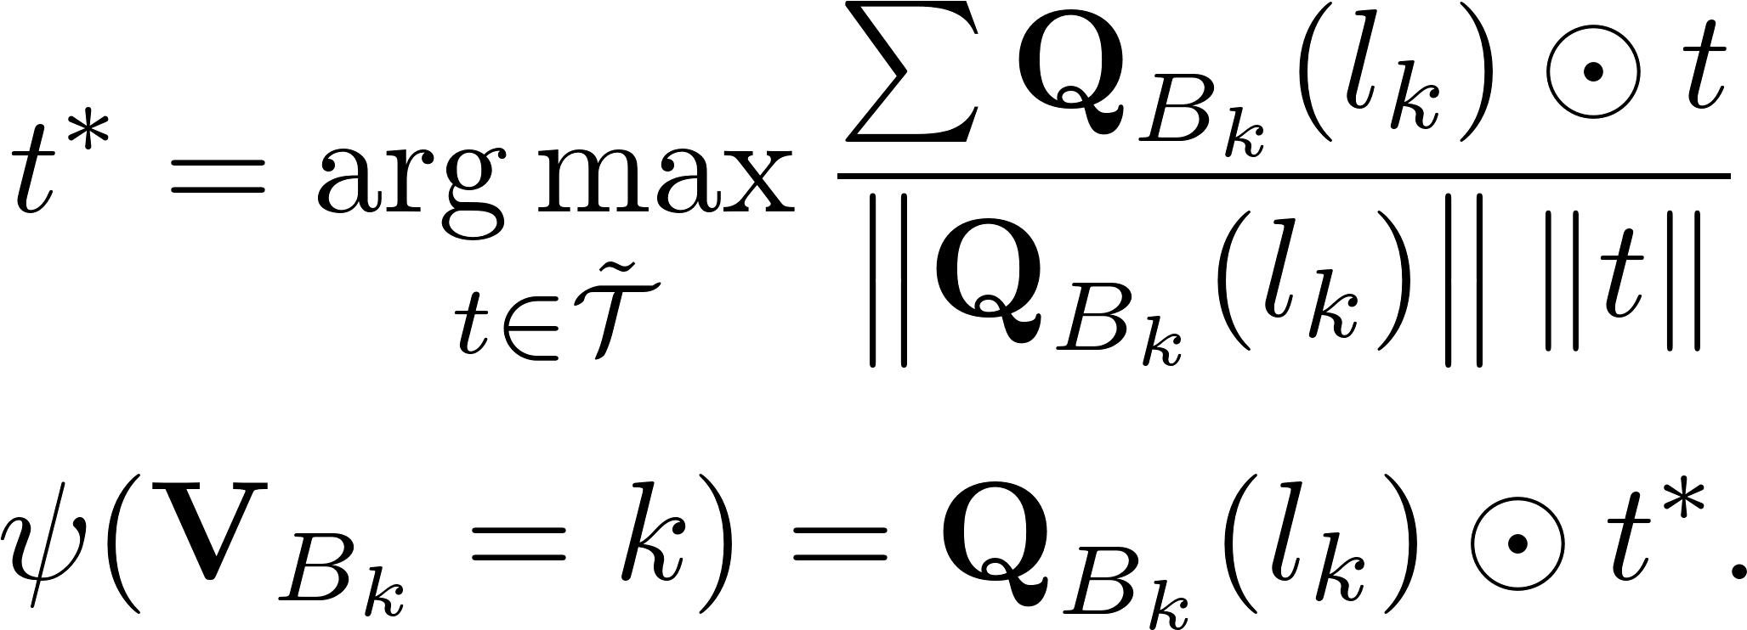
Shape Term
Match shape templates to objects
Shape templates are weights within the network
Update shape templates through backpropogation
Layer is effectively a convolution and max over channels
Initialised with old shape prior methods
Notes:
In this case, our network has a set of weights, which act as sort of shape templates.
For each bounding box, the shape template is warped onto the bounding box, and the template that matches the best with the foreground object class, in terms of the normalised cross correlation, is chosen.
This is effectively a convolution, followed by a max over channels, which makes it fit easily within neural network architectures.
The shape templates are updated by backpropogation, but are initialised smartly by clustering shapes from the training set.

Slide 16
Inference of CRF
Our predicted instance segmentation is the MAP of the CRF.
Minimise the CRF energy
Use approximate mean-field inference which can be unrolled as part of the neural network.
Enables end-to-end training
Notes:
Our final instance segmentation prediction is the MAP estimate of the CRF that we have defined.
This corresponds to minimising the energy of the CRF within the network.
To do this, we use approximate mean-field inference which can be unrolled to form an RNN.
This enables end-to-end training.

Slide 17
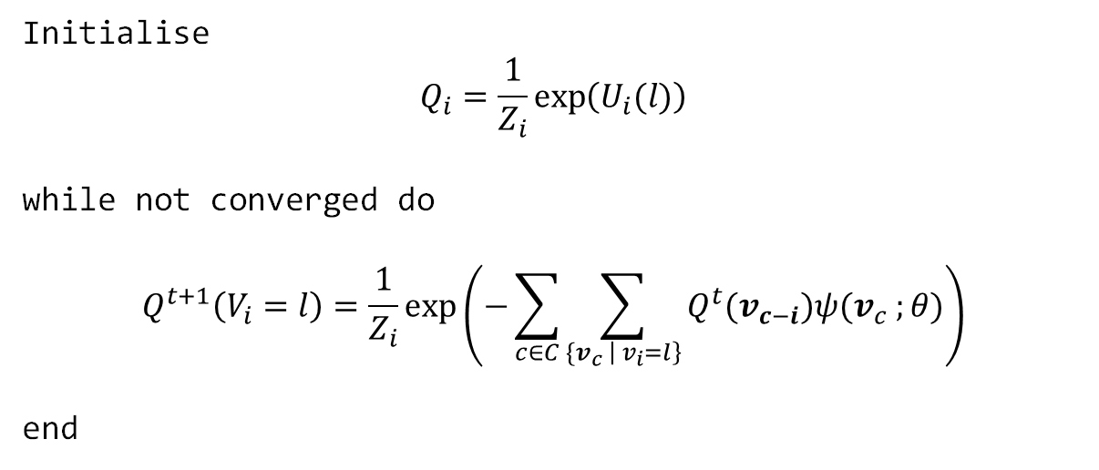
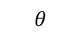
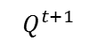
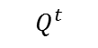
Mean Field Inference of CRF
$$Q^{t}$$
MF Iteration
$$Q^{t+1}$$
An approximate method. Works well in practice
$$θ$$
Initialise
$$Q_{i}=\frac{1}{Z_{i}}\exp\left(U_{i}(l)\right)$$
while not converged do
$$Q^{t+1}\left(V_{i}=l\right)=\frac{1}{Z_{i}}\exp\left(−\sum_{c∈C}{\sum_{{\{v}_{c} \left| v_{i}=l\right\}}{Q^{t}(v_{c−i}}})ψ(v_{c} ;θ)\right)$$
end
Linear with respect to Q
[1] Zheng and Jayasumana et al. ICCV 2015. [2] Arnab et al. ECCV 2016
Notes:
Mean-field approximates the true probability distribution, P, with a simple, fully factorised distribution, Q.
And by minimising the KL divergence between P and Q, we end up with an iterative algorithm.
The thing to note is that this iterative update is easy to implement as a layer with a neural network.
The gradient of the output with respect to the input is quite simple, since it is linear.
And if the potential functions of our CRF are differentiable, then we can learn their parameters using backpropogation too!.
If we unroll multiple iterations of mean-field, then we end up with an RNN.

Slide 18
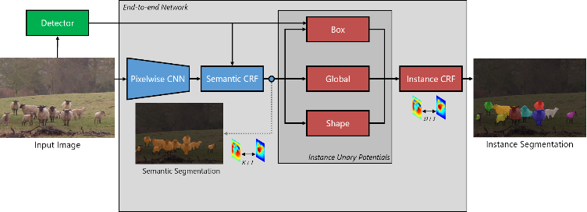
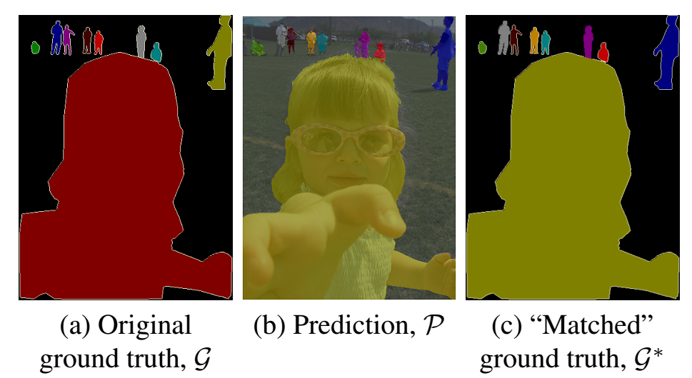
Loss Function
“Match” prediction to ground truth, since permutations of an instance labelling are actually the same result
Once matched, use any loss function. Log likelihood worked the best.
Notes:
So now that we have unrolled the inference of the CRF in our network, we just need a loss function to train it with.
Instance segmentation is permutation invariant – it does not matter who we label “Person 1” and “Person 2”.
To handle this, we “match” our prediction to the ground truth.
And then on this “matched ground truth”, we apply any loss function.
So the simple pixelwise log-likelihood worked the best for this.
We basically do bipartite matching, where the edge-weight is the IoU between the two segments. This can be done efficiently on each forward pass.
Note that most instance segmentation methods deal with independent object proposals, and so they do not deal with the issue of permutations.

Slide 19
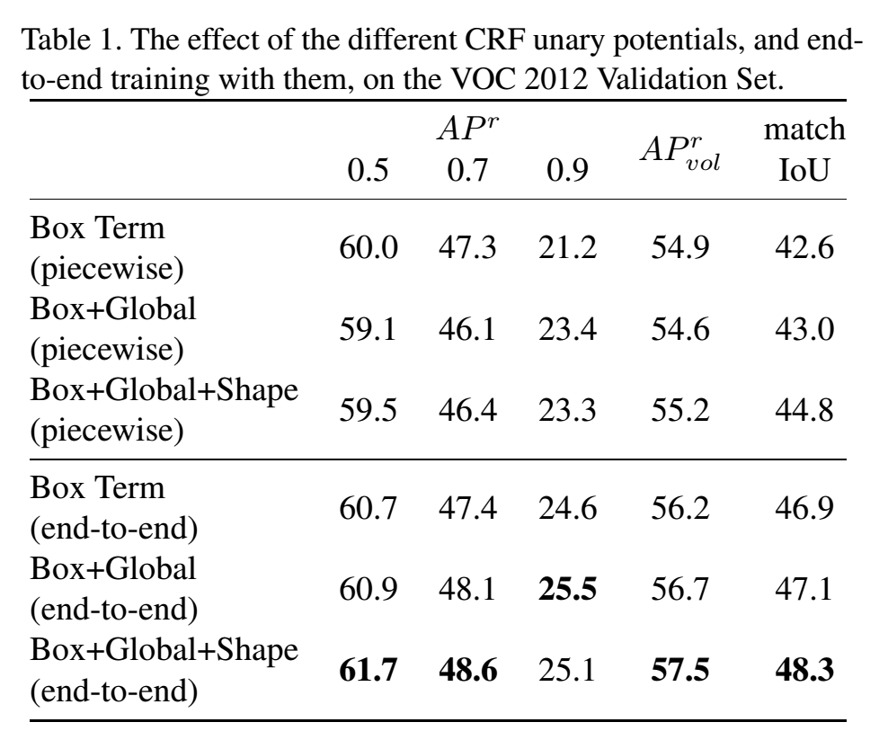
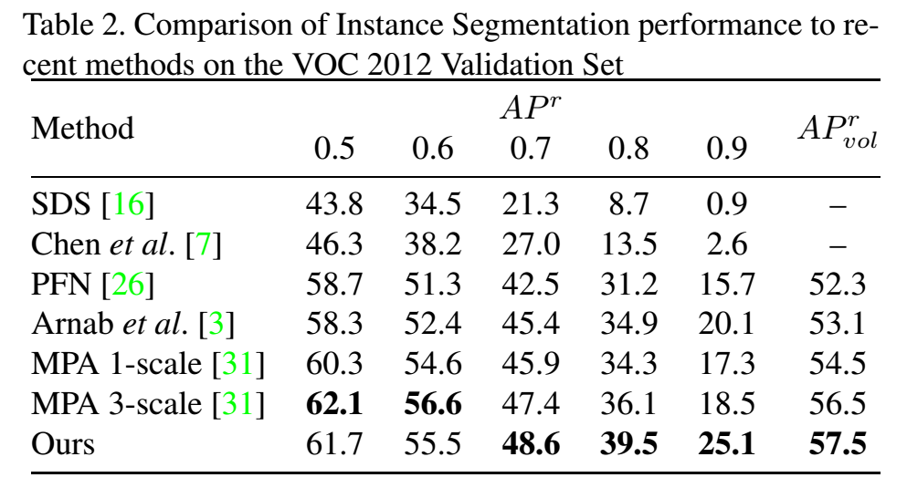
Results - VOC
Notes:
So in terms of results, we first evaluated on Pacsal VOC.
You can see that end-to-end training gives consistent improvements to our results.
Furthermore, we are better than previous work.
The main metric for instance segmentation is the Average Precision (AP). A similar metric is used in object detection. But there, a prediction is considered correct if the predicted and ground truth bounding box have an IoU of at least 0.5.
Here, we calculate the IoU between segments. Moreover, we vary the threshold.

Slide 20
Results - VOC
Notes:
As you can see here, the higher the AP threshold, the more we improve over previous work by.
This is because our system is based on an initial semantic segmentation network which outputs precise segmentations.

Slide 21
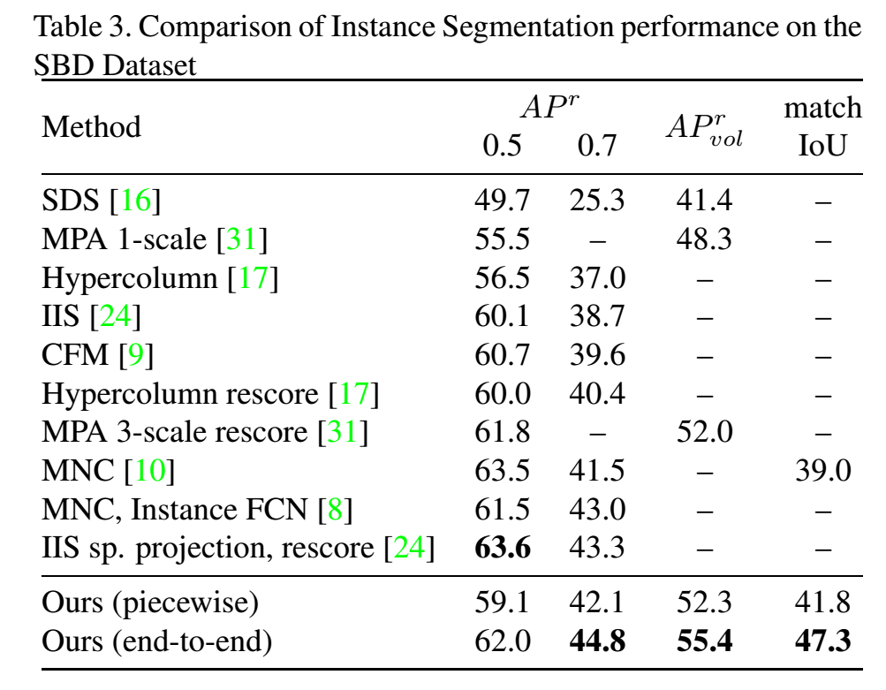
Results - SBD
Notes:
We notice a similar trend on the SBD dataset, which is another split of Pascal VOC.

Slide 22
Results - SBD
Notes:
We also use the “Matching IoU” as an additional performance metric.
Basically, after matching the ground truth and the prediction, we compute the IoU between the two.
I used the publicly available code for MNC, which won the COCO challenge, and worked out its matching IoU. We can see that it is quite a lot lower than ours although its AP at 0.5 overlap is higher than ours.
This suggests that the Average Precision is not fully indicative of instance segmentation performance.

Slide 23
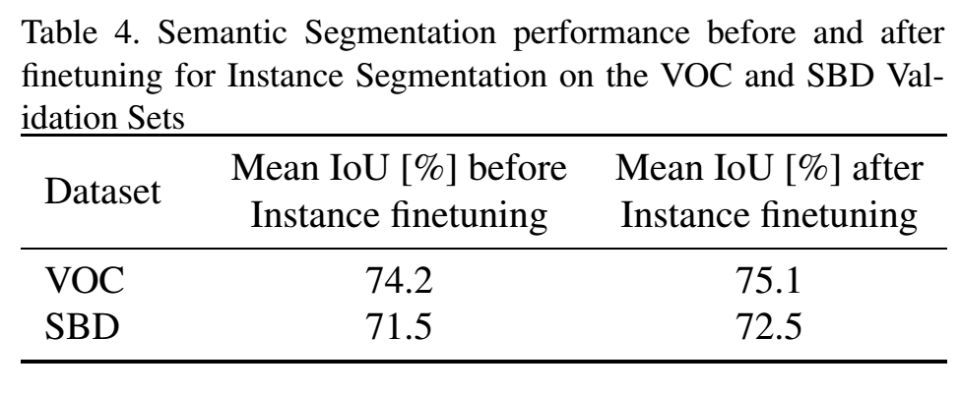
Training for Instance Segmentation improves Semantic Segmentation!
Notes:
Additionally, we found that training for instance segmentation improves semantic segmentation performance.
So we basically first train a semantic segmentation model.
We then append the instance subnetwork to it, and finetune the entire network.
Thereafter, we take the predictions after the semantic segmentation stage of the network and found that they had improved a bit.
This is probably because the unary terms for the instance segmentation depend on the semantic segmentation output. So to improve the instance segmentation, the network has to improve its semantic segmentation as well.

Slide 24
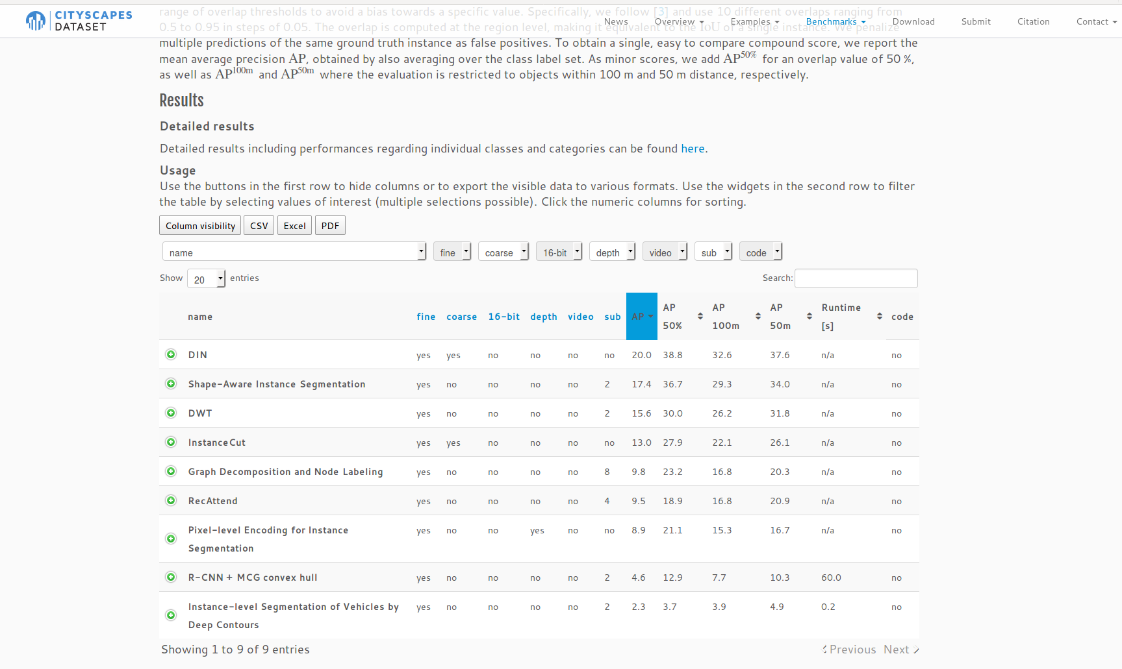
Results - Cityscapes
Notes:
Finally, we also evaluated on Cityscapes.
And it was the best performing method for a couple of months.
Now Mask RCNN is the best.

Slide 25
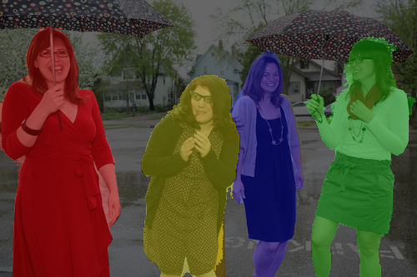
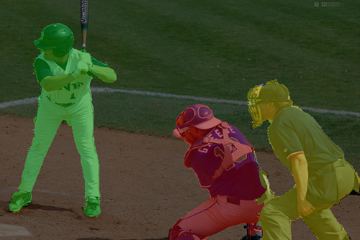
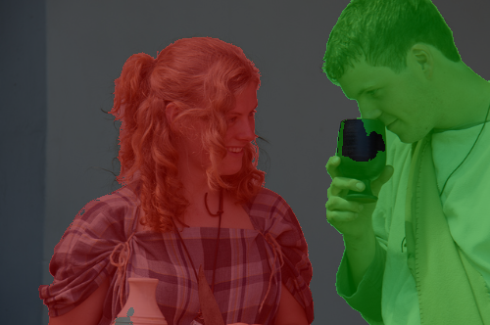
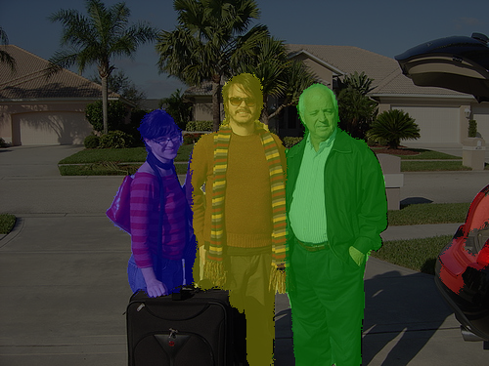
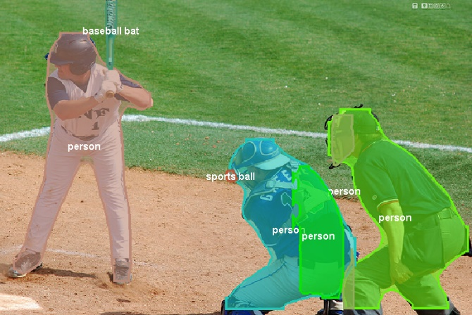
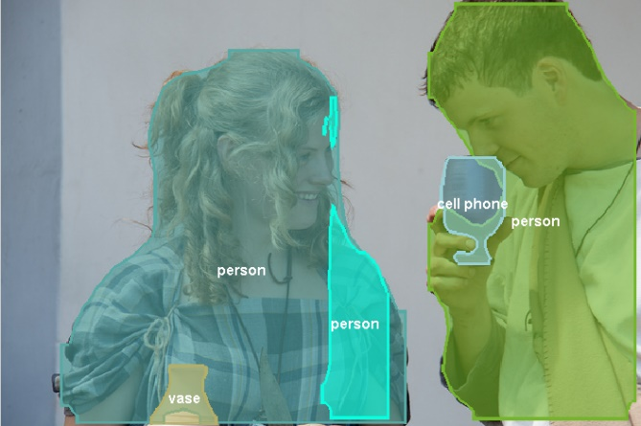
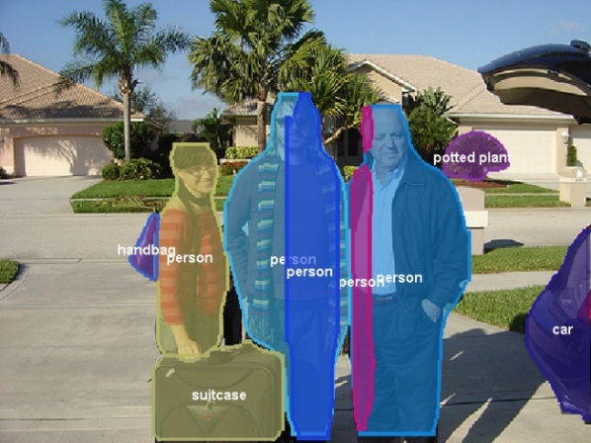
Comparison to FCIS
Ours
(VOC)
FCIS
(COCO)
[1] Qi et al. CVPR 2017.
Notes:
So before, I showed you some images where the current COCO winner performs quite badly.
Here are our results in comparison.
Also note that our model has been trained on VOC, and not COCO.

Slide 26
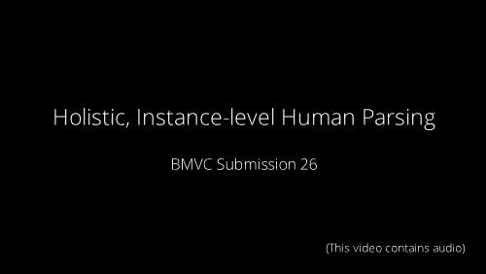

Slide 27
Conclusion
Network that jointly performs Semantic and Instance Segmentation
Output a variable number of instances per image.
More accurate segmentations than previous detection-based approaches.
Unlike detection-based approaches (ie Mask R-CNN), one pixel belongs to only one instance.
Network attempts to deal with occlusions.
No post-processing required.

Slide 28
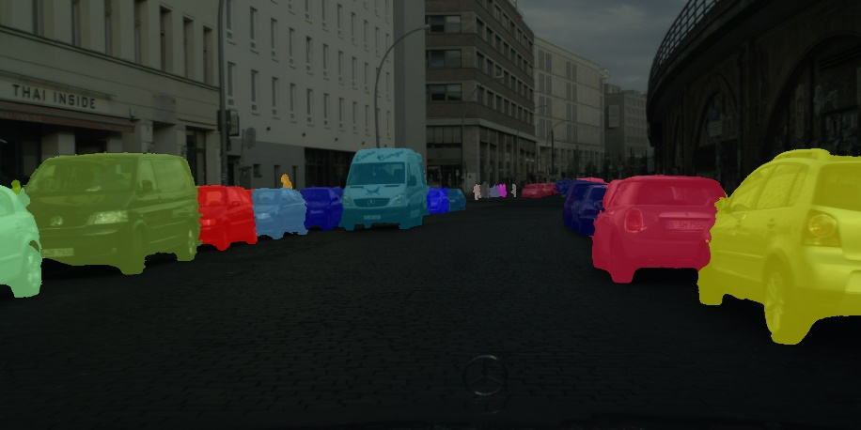
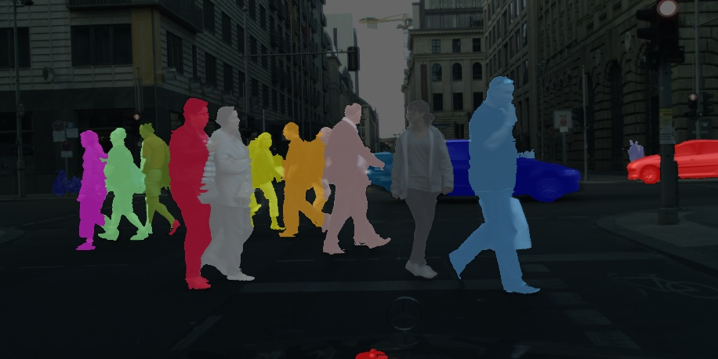
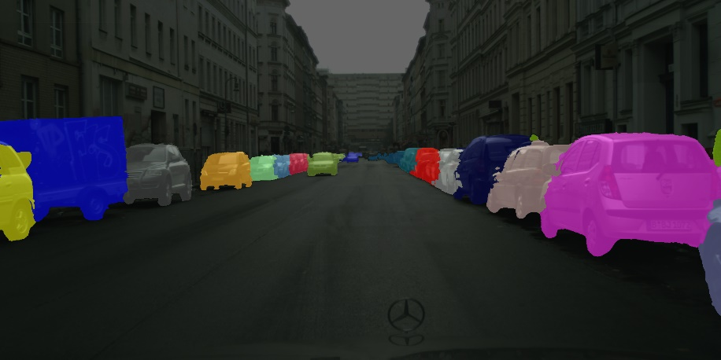
Questions?
Anurag Arnab, Philip H.S. Torr. Pixelwise Instance Segmentation with a Dynamically Instantiated Network. CVPR, 2017
Qizhu Li*, Anurag Arnab*, Philip H.S. Torr. Holistic, Instance-Level Human Parsing. BMVC, 2017
Anurag Arnab, Sadeep Jayasumana, Shuai Zheng, Philip H.S. Torr. Higher Order Conditional Random Fields in Deep Neural Networks. ECCV, 2016

